Slide 1
Task 3 — Propulsion System
1
My propulsion choice for the 10-inch search-and-rescue drone
Motor
Propeller
Requirements
Holybro S500 V2
2216 — 920KV
1045 / 10 × 4.5
Specified in the task
> 12 min endurance
Total weight < 2.5 kg
Main goal
Pick a battery + ESC combination that is compatible with the given motor and prop while keeping enough energy for more than 12 minutes of flight.
Task 3 requirements: 10-inch drone, specified motor + prop, choose battery and ESC, show calculations, >12 min endurance, <2.5 kg. Source: supplied task deck.

Slide 2
Motor + Propeller
2
I keep the given motor and 1045 propeller fixed for the main design.
Motor
ESC
Propeller
motor power
electrical
2216-920KV
4 motors
20A BLHeli S
4 ESCs
1045
10 × 4.5
Why 20A ESC?
Holybro uses a BLHeli S 20A ESC with the 2216 KV920 motor and 1045 propeller in the S500 V2 system, so I am using the same matched combination for my main design.
Task 3 requirements: 10-inch drone, specified motor + prop, choose battery and ESC, show calculations, >12 min endurance, <2.5 kg. Source: supplied task deck.

Slide 3
Battery Selection
3
I selected a 4S 5000 mAh LiPo because it is the largest value in the manufacturer recommendation.
Battery
Voltage
Energy
4S 5000 mAh
20C+
XT60
4 × 3.7 V
= 14.8 V nominal
5 Ah × 14.8 V
= 74 Wh nominal
Why this battery?
Holybro recommends 4S 3000–5000 mAh 20C+ for the S500 V2. I chose 5000 mAh because the extra capacity helps with the 12-minute endurance target.
Task 3 requirements: 10-inch drone, specified motor + prop, choose battery and ESC, show calculations, >12 min endurance, <2.5 kg. Source: supplied task deck.

Slide 4
Endurance Calculation
4
A simple energy-based calculation to check whether 12 minutes is realistic.
Step 1 — Usable capacity
Step 2 — Usable energy
Step 3 — 12 min limit
Assume 80% usable
5 Ah × 0.8 = 4 Ah
14.8 V × 4 Ah
= 59.2 Wh
12 min = 0.2 h
59.2 Wh ÷ 0.2 h = 296 W
Design meaning
For this simplified 80%-usable-energy calculation, average battery power needs to stay below about 296 W to get more than 12 minutes.
At 14.8 V, 296 W corresponds to about 20 A average battery current.
Task 3 requirements: 10-inch drone, specified motor + prop, choose battery and ESC, show calculations, >12 min endurance, <2.5 kg. Source: supplied task deck.

Slide 5
Manufacturer Reference Check
5
The manufacturer test gives a useful reality check for my calculation.
Holybro S500 V2 reference
My requirement
4S 5000 mAh battery
~18 min hover with no additional payload
2216 KV920 motors + 1045 props + 20A ESCs
Required: > 12 min
Manufacturer reference: ~18 min
So the chosen propulsion setup has a reasonable starting point for the requirement.
Important assumption
Real flight time will be lower if the drone is heavier, flies aggressively, fights wind, or carries extra payload. I would confirm the final endurance with a real flight test.
Task 3 requirements: 10-inch drone, specified motor + prop, choose battery and ESC, show calculations, >12 min endurance, <2.5 kg. Source: supplied task deck.

Slide 6
Power and Current Budget
6
This is the simple battery-level budget I would use for the design check.
Quantity | Calculation | Result
Battery nominal power | 14.8 V × 5 Ah | 74 Wh
80% usable energy | 74 Wh × 0.8 | 59.2 Wh
12-minute target power | 59.2 Wh ÷ 0.2 h | 296 W
Current at 12-minute limit | 296 W ÷ 14.8 V | 20 A
Average current per motor (simple split) | 20 A ÷ 4 | 5 A/motor
The 5 A/motor number is only an average design split, not the actual motor current at every throttle point.
Task 3 requirements: 10-inch drone, specified motor + prop, choose battery and ESC, show calculations, >12 min endurance, <2.5 kg. Source: supplied task deck.

Slide 7
Weight Budget
7
I need the final measured build to stay below 2.5 kg.
Item | Approx. mass / note
S500 V2 ARF with motors, ESCs, PDB, frame and props | ~782 g (manufacturer)
4S 5000 mAh battery | Use exact battery mass after purchase
Pixhawk + power module + GPS | Use actual selected hardware mass
OAK-D Lite | ~61 g
Raspberry Pi 5 (8 GB) | Use actual board + storage/cooling mass
RC + telemetry + VTX + wiring + mounts | Add actual masses
TOTAL | Must remain < 2500 g
The 782 g figure is the S500 V2 ARF weight. I should not treat it as the final whole-drone weight because avionics and battery still need to be added.
Task 3 requirements: 10-inch drone, specified motor + prop, choose battery and ESC, show calculations, >12 min endurance, <2.5 kg. Source: supplied task deck.

Slide 8
Final Propulsion Architecture
8
Battery power goes through the PDB to four ESCs and four motors.
4S 5000 mAh LiPo
14.8 V nominal
Power Module / PDB
Distributes battery power
Battery power
4 parallel branches
ESC 1
ESC 2
ESC 3
ESC 4
20A BLHeli S
20A BLHeli S
20A BLHeli S
20A BLHeli S
Motor 1
Motor 2
Motor 3
Motor 4
2216-920KV
2216-920KV
2216-920KV
2216-920KV
Task 3 requirements: 10-inch drone, specified motor + prop, choose battery and ESC, show calculations, >12 min endurance, <2.5 kg. Source: supplied task deck.

Slide 9
Final Selection + Bonus
9
My final propulsion choice for the main design.
Component | My selection | Reason
Motor | 4 × 2216-920KV | Specified motor in the task
Propeller | 4 × 1045 / 10×4.5 | Specified propeller in the task
ESC | 4 × 20A BLHeli S | Matches the Holybro S500 V2 setup
Battery | 4S 5000 mAh 20C+ | Largest recommended capacity; supports endurance target
Bonus — How I would compare an alternative motor
Key metric
I would compare thrust per watt, not just maximum thrust.
Efficiency = thrust (g) ÷ electrical power (W)
I would only call an alternative motor “better” after checking its thrust table with the same propeller and voltage.
Task 3 requirements: 10-inch drone, specified motor + prop, choose battery and ESC, show calculations, >12 min endurance, <2.5 kg. Source: supplied task deck.

Slide 10
Task 3 — Sources and Notes
10
Main numbers are tied to the manufacturer setup or clearly marked as design assumptions.
• Holybro S500 V2 documentation: 2216 KV920 motors, 20A BLHeli S ESCs, 1045 props, built-in PDB, 4S 3000–5000 mAh 20C+ battery recommendation.
• Holybro reports ~18 minutes hover with a 5000 mAh battery and no additional payload in its stated test setup.
• The 80% usable-energy assumption is my design assumption for a simple endurance check, not a manufacturer specification.
• The ~296 W / 20 A values are calculated thresholds for the 12-minute target under that assumption.
• Final drone mass and real endurance should be verified after the exact battery, avionics, wiring and payload are installed.
Sources: official Holybro S500 V2 documentation + supplied task deck.

Slide 11
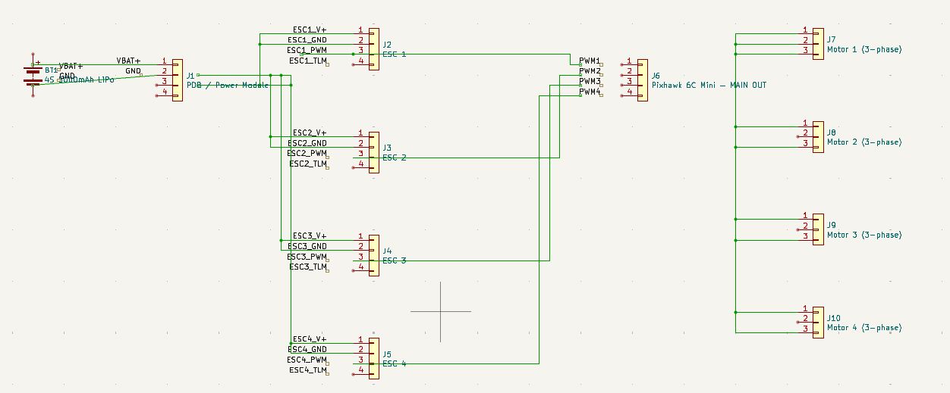
KiCad Connection Architecture
I/O-level propulsion connections for my Task 3 design
My check
✓ Battery → PDB power connections are shown.
✓ ESC V+ / GND and PWM signal connections are shown.
✓ Pixhawk MAIN OUT is used for ESC control.
! Motor 3-phase wiring needs correction before I submit.
! Each motor must have its own 3 separate phase wires from its own ESC. They must not be joined together.
→ I will redraw the motor phase wires as ESC1 → Motor1, ESC2 → Motor2, ESC3 → Motor3, ESC4 → Motor4.
Important: I would fix the motor phase wiring in KiCad before exporting the final schematic for submission.
11

Slide 12
Task 3 Bonus — Alternative Motor
I looked for a motor setup that can give higher thrust without needing as much input power.
Current setup
Alternative candidate
Holybro 2216 KV920 + T1045 4S / 16 V test point
T-Motor XMM3115 KV900 6S / ~22 V + C10.5×5×3
At 100% throttle: Thrust = 1332 g Power = 260 W Current = 16.37 A Efficiency = 5.13 g/W
At 50% throttle: Thrust = 1475 g Power = 217 W Current = 13.69 A Efficiency = 6.80 g/W
Result: 1475 g > 1332 g thrust, while 217 W < 260 W in these published test points.
Source: T-Motor published AIR2216II KV920/T1045 test data and XMM3115 KV900 test data. The comparison is not perfectly apples-to-apples because the alternative uses 6S and a 10.5×5×3 propeller, so I would bench-test it before changing the final design.

Slide 13
Bonus Conclusion — What I Would Do
The bonus motor looks promising, but I would keep the specified motor for the main design unless testing confirms the improvement on my actual drone.
Why the alternative is interesting
It has a larger 3115 stator and, in the published test point, gives more thrust with less electrical power. This could improve thrust margin and potentially help with payload.
Checks I would do before switching
• Check that the 3115 motor physically fits the 10-inch frame.
• Use an ESC rated for the alternative motor current; do not reuse the 20 A ESC blindly.
• Check the new battery voltage and propeller combination.
• Compare flight time and motor temperature on the real drone.
Final bonus answer: T-Motor XMM3115 KV900 is a promising alternative, but I would keep Holybro 2216 KV920 as the main build because it is the motor already specified in the task and its 20 A ESC / 1045 prop combination is already documented by Holybro.

